Slide 1
Engineering Ethics Dr. Rania Ramadan lecture 5: Ethical Problem-Solving Techniques

Slide 2
Intro
In early 1990s, some studies about risk of cancer due to living near electrical distribution systems, and even due to use of household items such as electric blankets.
This is because of weak, low frequency magnetic fields.
Should you, as an engineer with ethics, design such systems?

Slide 3
Introduction
We know theories, we need to analyze.
We seek formulas, but none exists.
Some problems are easy (like stealing), but most problems are not (may have contradicting principles).

Slide 4
Understand all involved issues
Defining and understanding all involved issues frames the problem in hand and usually points to the solution.
Issues types:
Factual
Conceptual
Moral

Slide 5
Factual Issues
You should know the facts first.
Are they really facts?
Usually, controversial.
Global warming due to greenhouse gases emission (like carbon dioxide), controversial issue, not fully understood.

Slide 6
Conceptual Issues
Concerns about meaning.
Is it a bribe or a gift? Is this piece of system info copyrighted?
Controversial.

Slide 7
Moral Issues
What principles are relevant

Slide 8
How to resolve controversial issues?
More research
More analysis

Slide 9
Case Study: Paradyne
Factual:
There were no existing system (as required)
Use of former employer to affect decision
Conceptual:
Is bidding for under-development system lying?
Is putting a wrong label deceptive?
Is lobbying former employer for the sake of current employer a conflict of interest?

Slide 10
Case Study: Paradyne (cont.)
Paradyne: We just made common business practices.
Moral Issues:
Is lying is acceptable in business?
Is it Ok to deceive to get a contract?
If (conceptually) it was a dishonesty, then it was unethical.

Slide 11
Line Drawing
Gray area, which ethical principle to apply?
At one end, positive paradigm, clearly ethical behavior situation, and vice versa.
In between, several hypothetical examples.

Slide 12
Line Drawing Example
Dumping toxic waste into local lake with 5 parts per million (ppm) limit is 10 ppm

Slide 13
Line Drawing Example (cont.)
1. At 5 ppm harmless, but unusual taste of water.
2. Effectively removed by the town’s existing water-treatment system.
3. Removed with new equipment purchased by the company.
4. Removed with new equipment for which the taxpayer will pay.
5. Occasionally, people feel ill, but this only lasts for an hour and is rare.
6. At 5 ppm, some people can get fairly sick, but the sickness only lasts a week, and there is no long-term harm.
7. Equipment to further reduce the waste level to 1 ppm.

Slide 14
Line Drawing Example (cont.)
Seems acceptable, but may be there better choices, should investigate more.
Political and community considerations

Slide 15
Line Drawing pitfalls
Subjective (biased)
Needs honesty and objectivity
Only ethically useful if used properly.

Slide 16
Line Drawing Example 2 – Intel Chips
1. There is a flaw in the chip, but it truly is undetectable and won’t affect any customer’s applications.
2. There are flaws in the chip, the customer is informed of them, but no help is offered.
3. A warning label says that the chip should not be used for certain applications.
4. Recall notices are sent out, and all flawed chips are replaced.
5. Replacement chips are offered only if the customer notices the problem.

Slide 17
Flow Charts
Known in engineering: computer programs, business processes.
In Ethics: a series of events/consequences.
Visual tool.
As line drawing:
No single correct solution
Needs objectivity and honesty

Slide 18
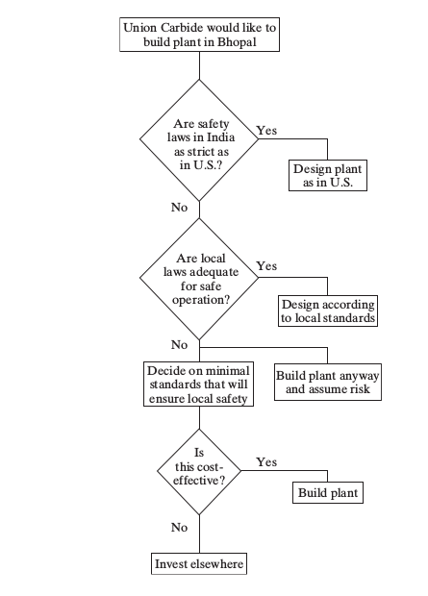
Flow Charts Example (Bhopal)

Slide 19
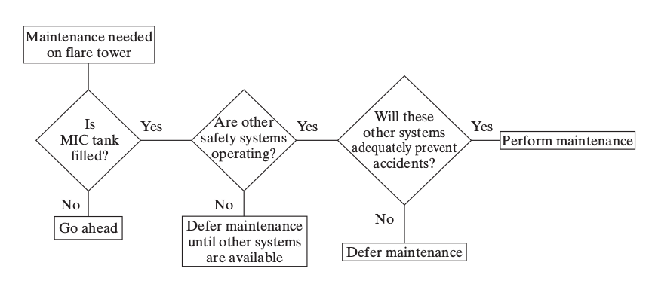
Flow Chart Example (cont.)
Flare tower maintainance

Slide 20
Flow Chart (cont.)
Real ethical problems need more complex charts: all possible events
The keys:
To be creative to foresee all possible scenarios
To not be afraid of negative results and canceling a plan

Slide 21
Conflict Problems
Conflict between 2 (or more) moral values, which to choose?
3 ways:
One is obviously more important than the other (public safety is more important than loyalty to employer)
Creative middle way (redesign system, pre-treat chemical waste, pay for treating equipment at water station) → usually no one is completely satisfied, you need to be creative and sell the solution
Make the hard choice based on available info and using your intuition (gut feeling)

Slide 22
An application
Is it a bribe or a gift?
Bribery is illegal EVERYWHERE
Bribery is bad because:
It corrupts free-market economy
It corrupts justice, the rich set the rules
It humiliates humans, treats then like things for sale

Slide 23
Bribery
Definition: to give money (or gift or favor) in exchange for an advantage
A calendar or a coffee mug is usually acceptable (really???)
A business dinner is a common business practice (but what if it is an expensive meal and they pay for you?)

Slide 24
Some open questions
A sales representative:
Offers a 5$ coffee mug with company’s logo? 350$ crystal bowl with logo? Without logo?
Invites to a launch in a fast food local restaurant and you pay for yourself? An expensive French restaurant? She pays?
Asks to a tennis match at local club? Exclusive club? She pays for the guest fee?
Invites to one-day seminar at another city and your company pays? In Hawaii? They pay? With your family?

Slide 25
Cont.
Before you ever buy from them vs you are a regular customer, does it make a difference?
What about your future decisions?
Do they need to secure you as a regular customer?
Do other engineers at your company expect the same?
What about small companies who cannot afford?
What about the total cost (including bribes)?
Bribery is evil.

Slide 26
Problem Solving
Factual: Who? When? What? Why?
Conceptual: Is the value enough to affect decision? Was the intent is bribery?
Moral: Should be clear.
Line drawing and flow charting (if done correctly ) can help greatly.

Slide 27
How to be sure?
How to decide to accept a gift or refuse a bribe?
Look for corporate policy
Ask for management approval

Slide 28
Cases

Slide 29
Cellular Phones and Cancer
Different Case: no (clear) disaster
David Reynard in 1992, lawsuit, his wife’s cancer due to use of cell phone
Case dismissed in 1995, lack of scientific evidence, but after raising concerns

Slide 30
The problem
Use of radio-magnetic source (even with small power and different frequency) very close to your brain.
This is not usual in human history
Microwave cooks food!

Slide 31
Studies
Many studies in rf effect, (back to 1940s) Correlates the health problem (cancer) to level of exposure to rf radiation
They reported no harm of cell phones. Still:
Relied on self reporting
Hard to analyze (what is the power level?- depend on the phone, the distance)
Brain cancer take long time to develop
Solid links: After 10 or 20 years, maybe

Slide 32
Studies (cont.)
Experiment on laboratory animals
Reported no health problems
But they are animals!
Some theoretical studies: how rf is deposited in human brain during cell phone usage.
Hard to measure
In 2011, a reported study: 7% brain activity increase in areas close to phone antenna
How this is significant: to be determined

Slide 33
As an engineer: what to do?

Slide 34
Vice President Spiro Agnew
Lester Matz, a partner in Matz, Childs and Associates
Contracts are not offered for bidding, but chosen directly based on firm’s history and performance.
Matz, despite doing good, did not get contracts.
He decided that he needs relations.

Slide 35
Vice President Spiro Agnew (cont.)
1961, Matz chosen Spiro Agnew, a rising politician.
Paid $500 for Agnew county executive campaign
After winning, Matz paid 5% from contracts fees to Agnew
Matz became rich, apartment for ski winter vacation, beach condo near to Agnew’s one
Agnew became governor of Maryland, Matz took state contracts.

Slide 36
Vice President Spiro Agnew (cont.)
Agnew became vice president (with Nixon)
Matz said he gave him an envelope with $10000 in white house
$2500 for a federal contract
In total, $100000, Matz said
To provide cash needed for bribery:
Bonuses
Loans

Slide 37
Vice President Spiro Agnew (cont.)
When threatened by tax charges, Max talked about Agnew
Finally, Agnew resigned as vice-president, paid $10000 fine, under unsupervised trial for 3 years
Matz and Childs were not prosecuted!

